Slide 1
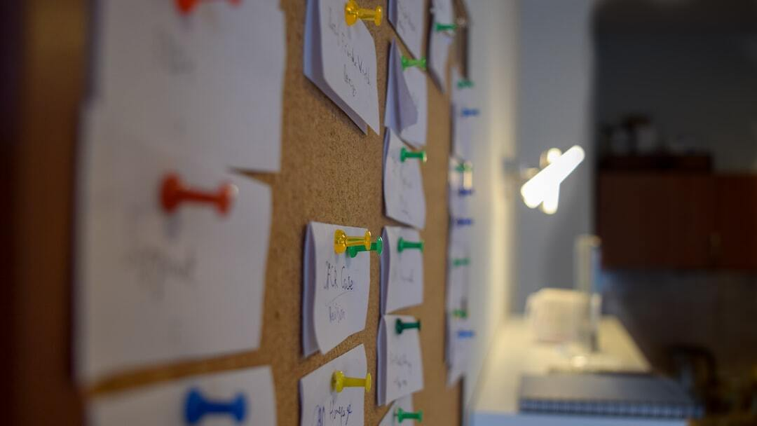
Data Science Project – Customer Segmentation using Machine Learning in R
Overview: Customer Segmentation is a key application of unsupervised learning that allows companies to identify different customer segments for targeted marketing.
Project Goal: To implement Customer Segmentation using K-means clustering in R.
Dataset: Mall_Customers.csv: Contains demographic data of mall visitors.
Photo by Digitawise Agency on Unsplash

Slide 2

Data Exploration
Importing Packages: Use the necessary R packages for data analysis and visualization.
Reading Data: Load the 'Mall_Customers.csv' dataset and inspect its structure using str() and head() functions.
Data Summary: Generate summary statistics and visualize data distribution using summary() and other descriptive statistics functions.
Photo by Ilija Boshkov on Unsplash

Slide 3
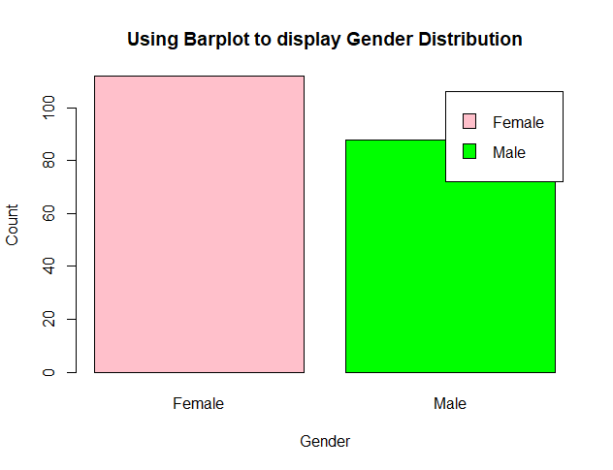
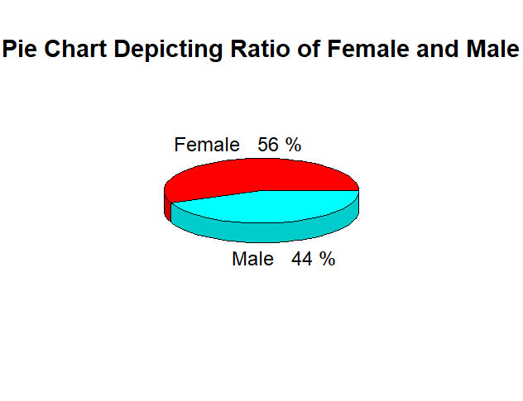
Customer Gender Visualization
Bar Plot: Code: a=table(customer_data$Gender) barplot(a, main='Using BarPlot to display Gender Comparison', ylab='Count', xlab='Gender', col=rainbow(2), legend=rownames(a))
Pie Chart: Code: pct=round(a/sum(a)*100) lbs=paste(c('Female','Male'), ' ', pct, '%', sep=' ') library(plotrix) pie3D(a, labels=lbs, main='Pie Chart Depicting Ratio of Female and Male')
Insights: The bar plot and pie chart show that the percentage of females is 56%, whereas the percentage of males is 44%.

Slide 4
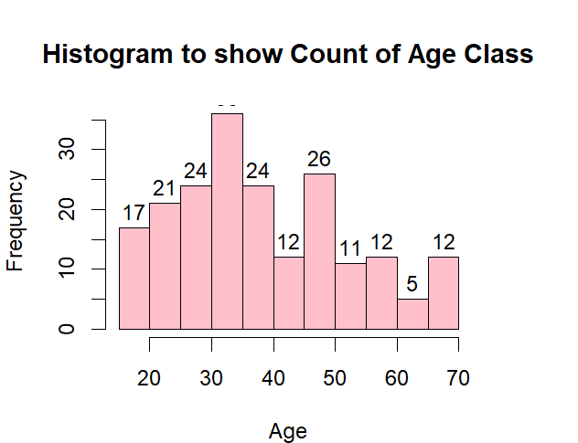
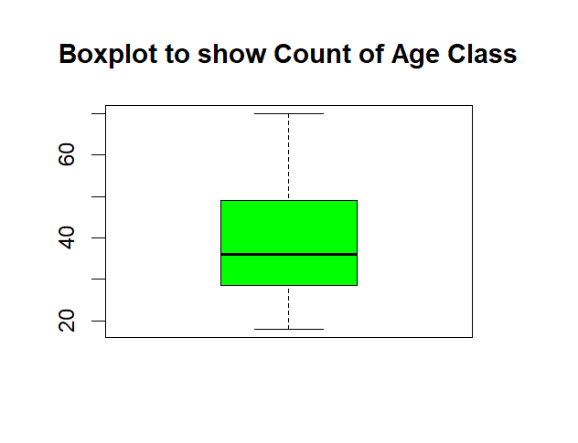
Age Distribution Visualization
Histogram: Code: hist(customer_data$Age, col='blue', main='Histogram to Show Count of Age Class', xlab='Age Class', ylab='Frequency', labels=TRUE)
Box Plot: Code: boxplot(customer_data$Age, col='ff0066', main='Boxplot for Descriptive Analysis of Age')
Insights: Most customers are between 30 and 35 years old. The minimum age is 18, and the maximum age is 70.

Slide 5
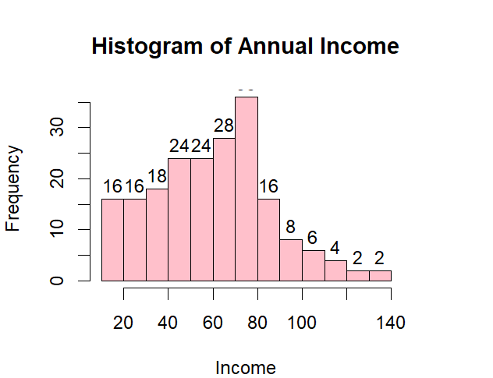
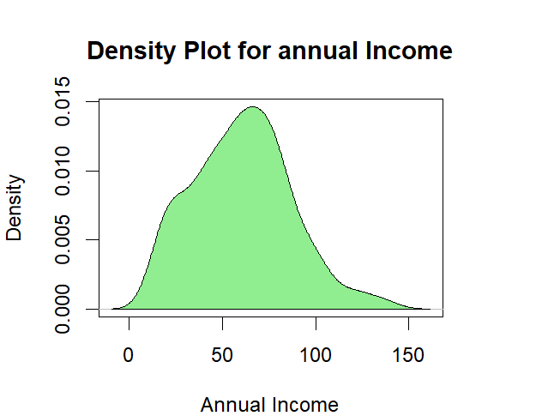
Annual Income Analysis
Histogram: Code: hist(customer_data$Annual.Income..k.., col='#660033', main='Histogram for Annual Income', xlab='Annual Income Class', ylab='Frequency', labels=TRUE)
Density Plot: Code: plot(density(customer_data$Annual.Income..k..), col='yellow', main='Density Plot for Annual Income', xlab='Annual Income Class', ylab='Density') polygon(density(customer_data$Annual.Income..k..), col='#ccff66')
Insights: The minimum annual income is 15k, and the maximum is 137k. The average income is 60.56k, with a normal distribution observed in the density plot.

Slide 6
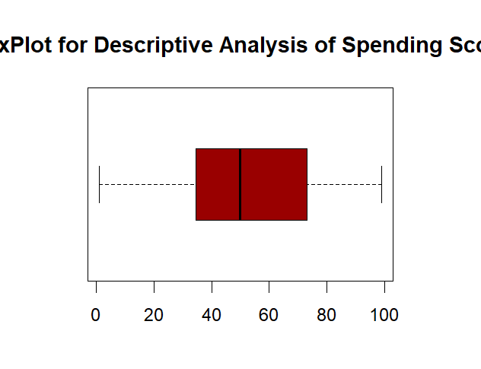
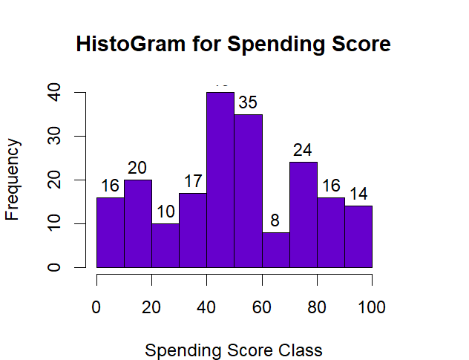
Spending Score Analysis
Box Plot: Code: boxplot(customer_data$Spending.Score..1.100., horizontal=TRUE, col='#990000', main='BoxPlot for Descriptive Analysis of Spending Score')
Histogram: Code: hist(customer_data$Spending.Score..1.100., main='Histogram for Spending Score', xlab='Spending Score Class', ylab='Frequency', col='#6600cc', labels=TRUE)
Insights: The minimum spending score is 1, the maximum is 99. Most customers have a median spending score of 50.

Slide 7
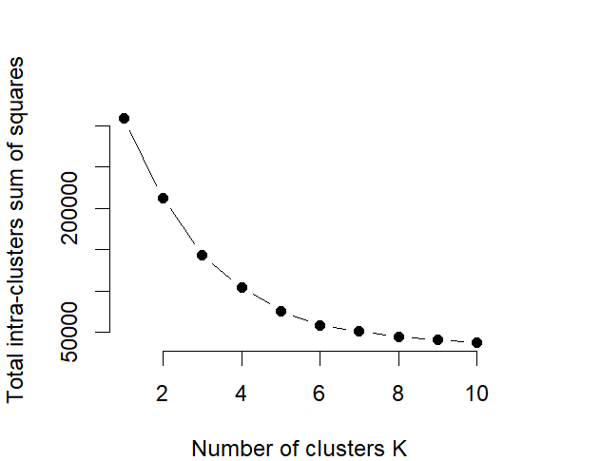
K-means Algorithm
Optimal Clusters: Use the elbow method to determine the optimal number of clusters by plotting the total intra-cluster sum of squares for different values of k.
Code Implementation: Code: library(purrr) set.seed(123) iss <- function(k) {kmeans(customer_data[,3:5],k,iter.max=100,nstart=100,algorithm='Lloyd')$tot.withinss} k.values <- 1:10 iss_values <- map_dbl(k.values, iss) plot(k.values, iss_values, type='b', pch=19, frame=FALSE, xlab='Number of clusters K', ylab='Total intra-clusters sum of squares')
Insights: The elbow plot shows that 4 is the optimal number of clusters as it appears at the bend in the graph.

Slide 8
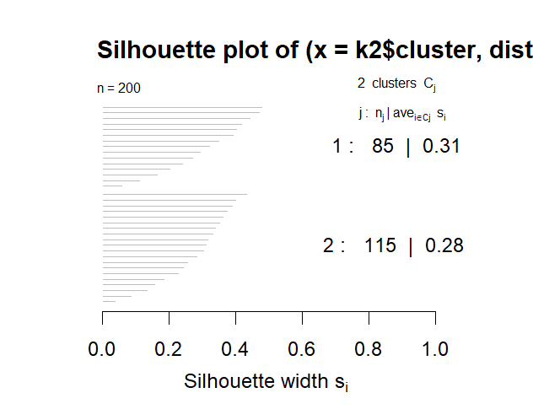
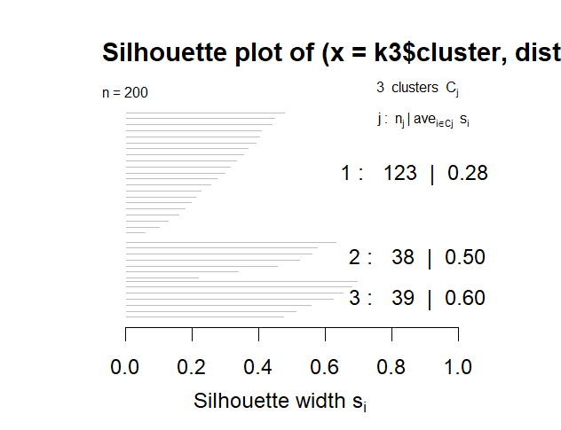
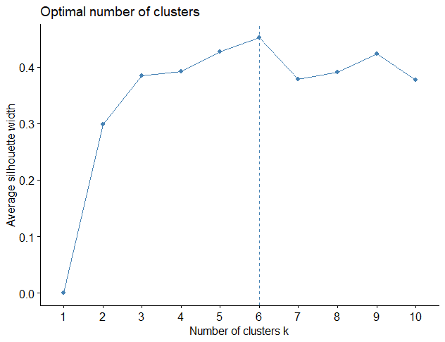
Average Silhouette Method
Introduction: The silhouette method is used to determine the optimal number of clusters by computing the average silhouette width for different numbers of clusters.
Code Implementation: Code: library(cluster) k2<-kmeans(customer_data[,3:5],2,iter.max=100,nstart=50,algorithm='Lloyd') s2<-plot(silhouette(k2$cluster,dist(customer_data[,3:5],'euclidean'))) k3<-kmeans(customer_data[,3:5],3,iter.max=100,nstart=50,algorithm='Lloyd') s3<-plot(silhouette(k3$cluster,dist(customer_data[,3:5],'euclidean')))
Insights: The optimal number of clusters is determined by the highest average silhouette width.

Slide 9
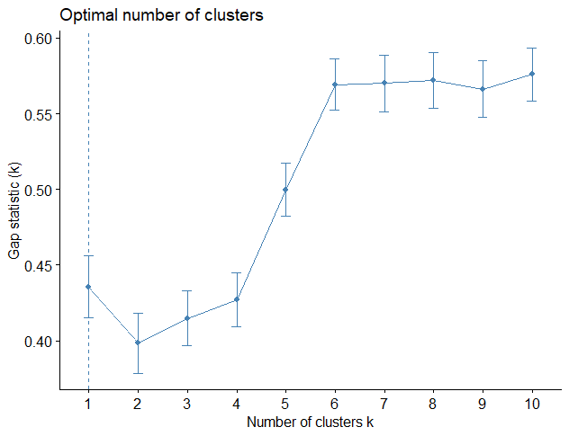
Gap Statistic Method
Introduction: The gap statistic method is used to estimate the optimal number of clusters by comparing the total within intra-cluster variation for different numbers of clusters with their expected values under null reference distribution.
Code Implementation: Code: library(cluster) stat_gap <- clusGap(customer_data[,3:5], FUN=kmeans, nstart=25, K.max=10, B=50) plot(stat_gap)
Insights: The optimal number of clusters is determined by the value of k that maximizes the gap statistic.

Slide 10
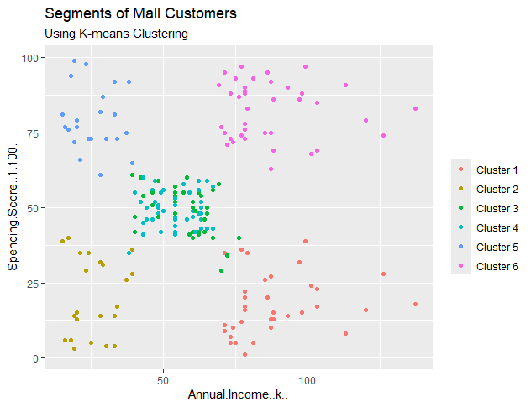
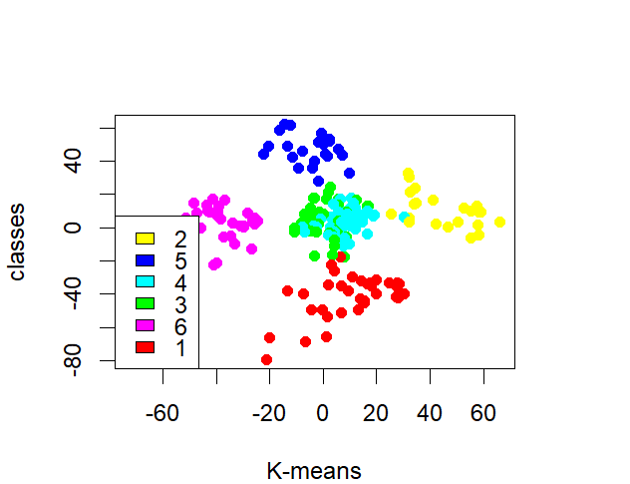
Visualizing Clustering Results
Principal Component Analysis (PCA): Perform PCA to reduce dimensionality and visualize the clustering results.
Cluster Visualization: Code: pcclust=prcomp(customer_data[,3:5],scale=FALSE) ggplot(customer_data, aes(x=Annual.Income..k.., y=Spending.Score..1.100.)) + geom_point(stat='identity', aes(color=as.factor(k6$cluster))) + scale_color_discrete(name='', breaks=c('1', '2', '3', '4', '5','6'), labels=c('Cluster 1', 'Cluster 2', 'Cluster 3', 'Cluster 4', 'Cluster 5','Cluster 6')) + ggtitle('Segments of Mall Customers', subtitle='Using K-means Clustering')
Insights: The visualization shows a clear separation of the six clusters based on their annual income and spending score.
Cluster 6 and 4 – These clusters represent the customer_data with the medium income salary as well as the medium annual spend of salary.
Cluster 1 – This cluster represents the customer_data having a high annual income as well as a high annual spend.
Cluster 3 – This cluster denotes the customer_data with low annual income as well as low yearly spend of income.
Cluster 2 – This cluster denotes a high annual income and low yearly spend.
Cluster 5 – This cluster represents a low annual income but its high yearly expenditure.

Slide 11

Summary and Conclusion
Project Recap: Recapped the key steps: data exploration, visualizations, and K-means clustering to segment customers.
Key Insights: Identified key insights: different customer segments based on demographic and spending patterns.
Future Work: Potential future improvements: incorporating more features, exploring other clustering algorithms, and applying the model to other datasets.

